Slide 1
project: finance Loan (predictive analysis)
By: Nirvan Jothi uthayajothi

Slide 2
Problem Statement
Project & objective
In the financial industry, it is crucial for lenders to assess the credit worthiness of borrowers before granting loans or credit. Identifying potential defaulters, who are at higher risk of failing to repay their debts, can help mitigate financial losses and maintain a healthy lending portfolio. The goal of this project is to develop a predictive model that can accurately classify borrowers as defaulters or non-defaulters based on various financial and demographic factors.
Research Objective
To create a machine learning model to predict the defaulter and Non-defaulter by analyzing historical data

Slide 3
Flowchart
Import the data
Clean the data
Understand the data
Model uses past data and outcomes to build rules for predicting defaults
Split into Training & Testing sets
Prepare the data for models
Model Predicts outcomes
(default status)
Compare Predictions vs Actuals
(real results)
Evaluation Metrics

Slide 4
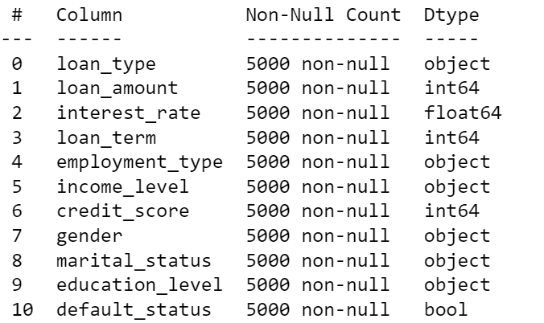
Data Understanding and Preparation
Python was used to conduct the analysis and predictions
All the necessary libraries are imported, along the way more libraries imported as needed. These libraries are needed in order to perform the analysis, predictions, calculations, plot graphs and more
The loan excel csv file was uploaded into python and viewed
Columns that were not needed for the analysis were removed such as dates and ids
Descriptive analysis was done to check the number of rows, columns, data types, any missing values, etc…
There are no missing values, the data type for all columns are in correct format (int & float for numbers, etc…)

Slide 5
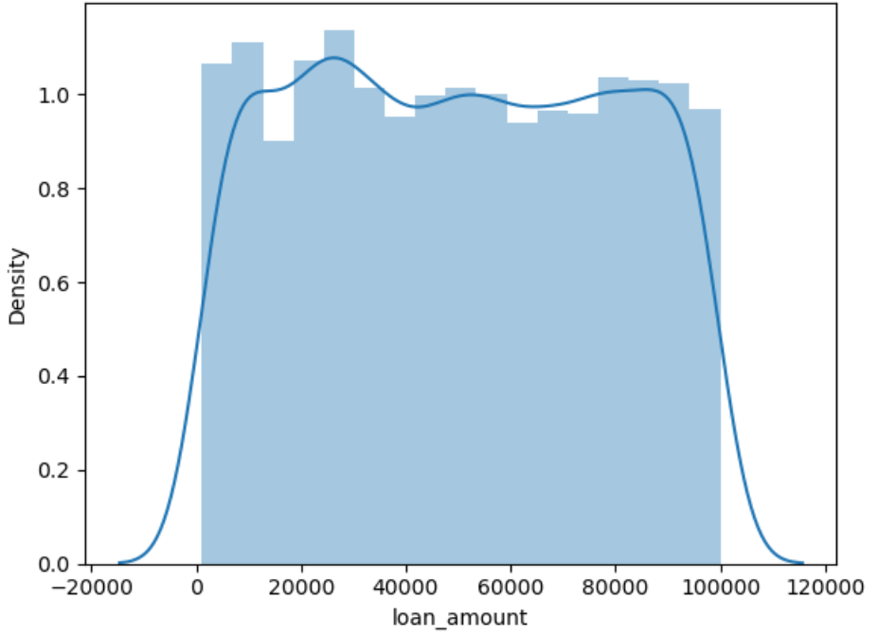
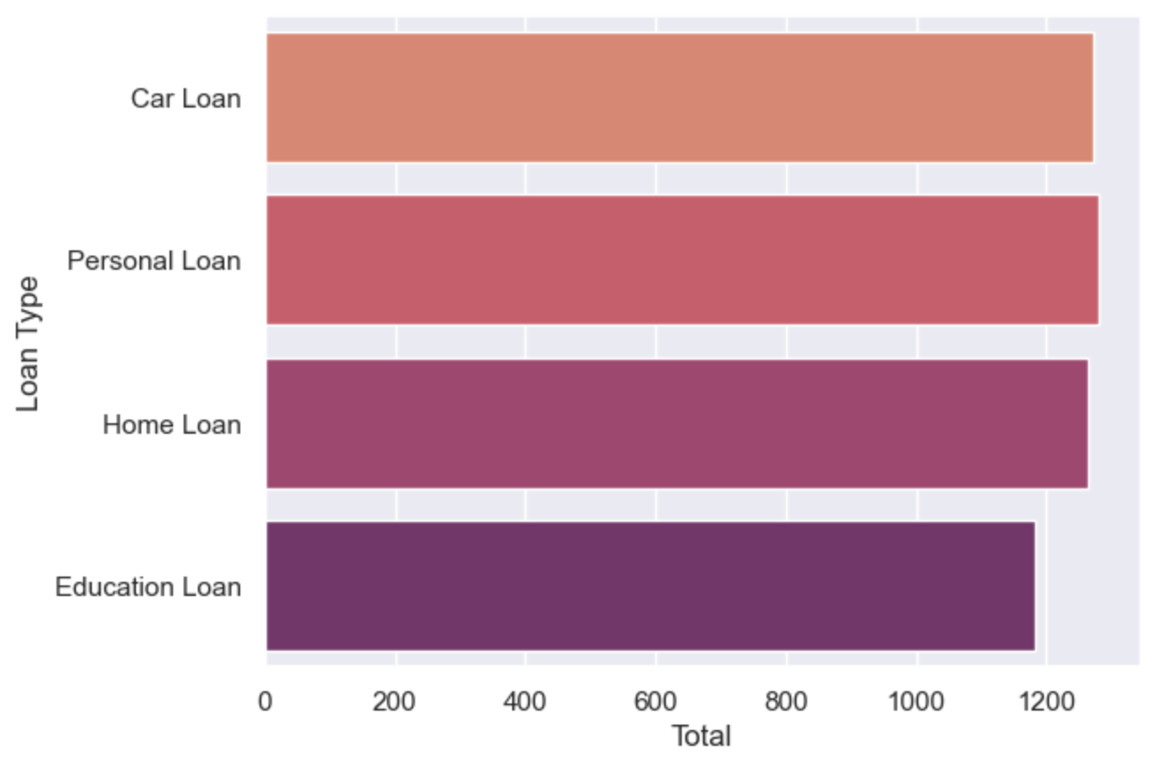
Data Understanding and Preparation
Exploratory data analysis (EDA)
To explore the data, methods were used to find the statistics, value counts, relationship between categories, spread of data in each category and to plot graphs
All the numerical columns/variables tend to have values which are spread centrally within a certain range making them close to or being symmetric
All categorical columns/variables tend to have category totals that are close to one another
There is no over or under sampling: no category of any categorical column/variable is exceptionally above or below the rest of the categories under the variable, and there are no values that are exceptionally above or below the rest of the values for any numerical column/variable

Slide 6

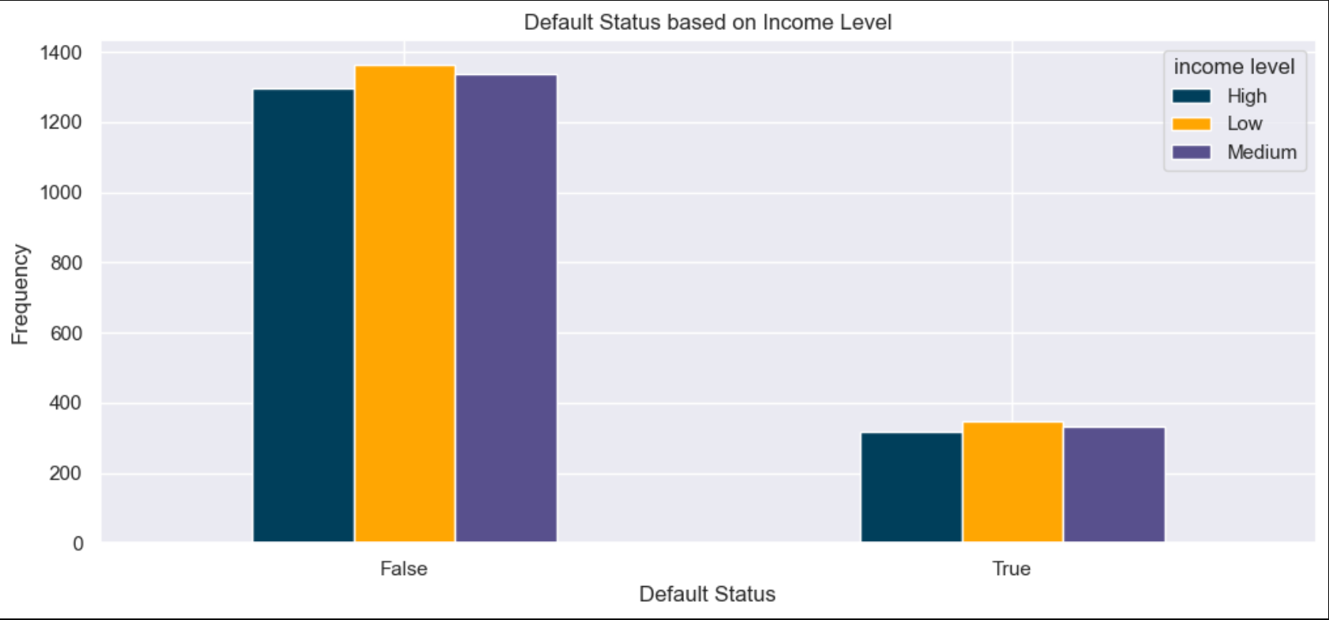
Data Understanding and Preparation
Exploring further, one example is plotting the default status based on income level to find out the frequency of which income level defaulted and did not default based on the data provided
There are 4001 false default status and 999 true defaults status, reaching 5000 records totally as per dataset provided. False default status meaning the customer is able to pay back the loan while if the customer defaults (true), meaning the customer is not able to pay back the loan
Non-defaulters (false) are higher in all income level categories, with low income level being the highest, followed by medium then high income levels
For the defaulters (true), low income level is the highest again, followed by medium then high income levels
We would expect for the non-defaulters (false) that high income level will be the most frequent and low income level the least frequent, however it is the other way around. May be influenced by other variables

Slide 7
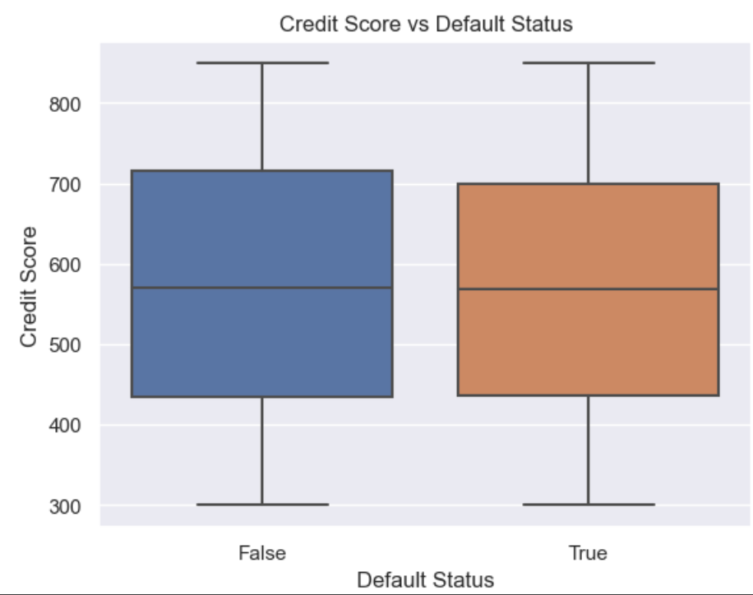
Data Understanding and Preparation
Exploring Credit Score with Default status (target variable), both false and true default status have similar values for their medians, maximum and minimum, lower quartiles, etc.
There are no outliers (values that are exceptionally high or low)
The spread of the data is identical for both categories and symmetric
Default Status
False True
Maximum: 870-880 870-880
Upper Quartile (75%): 710-720 700
Median (50%): 570-580 570-580
Lower Quartile (25%): 420-430 420-430
Minimum: 300 300

Slide 8
Data Preparation and modelling
For Python to be able to work with text columns, categories in all text columns are transformed into numbers (e.g. for income level: Low – 1, Medium – 2, High – 3)
To make predictions, different machine models have to be trained and tested on the dataset before making predictions on the target variable/column for new/unseen data
First, the dataset is broken down into two parts, train and test for both non-target variables and the target variable (default status)
During training, models are provided with both the non-target variables (features) and the target variable (default status). This allows them to learn the relationships needed to make predictions.
Once trained, to make predictions, the non-target variables that have been tested on the model are used to predict the target variable default status which are known as the predictions
The predictions are then compared to the actuals (real default status data in dataset) giving metrics like accuracy and recall
Scaling was applied to bring all input data into the same range, preventing any one variable with larger numbers from having too much influence on the model. This makes the training process more balanced and accurate

Slide 9
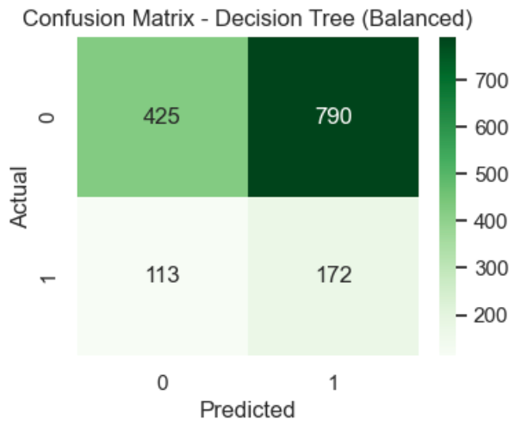
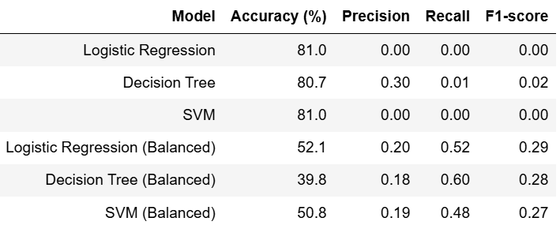
Result Interpretation
Comparing the predictions with the actuals, we then get the accuracy of the model for the correct predictions
For all models, 70% training and 30% testing sets were used with 5000 records:
425 + 790 + 113 + 172 = 1500
0.3 x 5000 = 1500
425 + 172 = 597 (Total predicted correctly)
(597/1500) x 100 = 39.8% Accuracy (Decision Tree (Balanced))
From the decision tree matrix after performing balancing, we can see for the target variable default status:
790 are predicted to be defaulters but are non-defaulters in actual
113 are predicted to be non-defaulters but defaulters in actual
425 are predicted correctly for non-defaulters
172 are predicted correctly for defaulters
Actual False, Predicted False
Actual False, Predicted True
Actual True, Predicted False
Actual True, Predicted True

Slide 10
Result Interpretation
Recall: how many of the actual defaulters the model was able to correctly identify
In credit scoring, recall is often more important than accuracy, because failing to detect defaulters can lead to losses.
Higher Recall means the model is better at detecting defaulters, even if accuracy drops
Recall = TP/(TP + FN)
True Positives (TP): Defaulters the model correctly predicted as defaulters
False Negatives (FN): Defaulters the model missed and predicted as non-defaulters
Recall = 172/(172+113)
= 0.6 (60%)
The model correctly detected 60% of all actual defaulters, demonstrating a good balance between sensitivity and accuracy
Actual False, Predicted False
Actual False, Predicted True
Actual True, Predicted False
Actual True, Predicted True

Slide 11
Result Interpretation
The data was imbalanced, meaning most borrowers did not default.
(80% Non-Defaulters (4001 of 5000), 20% Defaulters (999 of 5000))
Without balancing, the model ignored the defaulters to achieve higher accuracy
Balancing re-weights the data so the model gives equal importance to defaulters and non-defaulters,
instead of just focusing on the majority
After balancing, the model became better at recognizing defaulters, improving Recall from
nearly 0% to about 60%, helping us detect more risky borrowers
Before balancing → High Accuracy, Low Recall
After balancing → Lower Accuracy, High Recall
Actual False, Predicted False
Actual False, Predicted True
Actual True, Predicted False
Actual True, Predicted True

Slide 12
Result Interpretation
Running at different training and testing percentages, all models give accuracy of around 81% for the predictions, therefore since all are similar accuracy, the first set is chosen at 70% training and 30% testing
The dataset also falls under supervised learning therefore supervised learning models were used. Supervised learning means there are non-target variables and a target variable output (default status)
All models in all train and test sets have correct predictions around 81%, this is due to the spread of data being very similar in every column
However, the recall, which is an evaluation metric which shows the percentage of correctly predicted
actual defaulters, remains mostly at 0
70% training & 30% testing
To address this, balancing was done as shown in the previous slide for each model, resulting in higher recall, meaning the model is able to detect a larger proportion of actual defaulters

Slide 13
Result Interpretation
Purpose of models:
Logistic Regression – is used for predictive analysis and when the target variable is at least a binary (0&1) and explains the relationship between the target variable and the non-target variables, a s-curve graph
Support Vector Machines (SVM) – finds the best boundary to separate two class of data, positive and negative. Can be linear or non-linear
Decision Tree – A flow chart tree split into decisions based on the previous title, each split/branch is a result of the decision. Begins with one title and expands into many due to many decisions

Slide 14
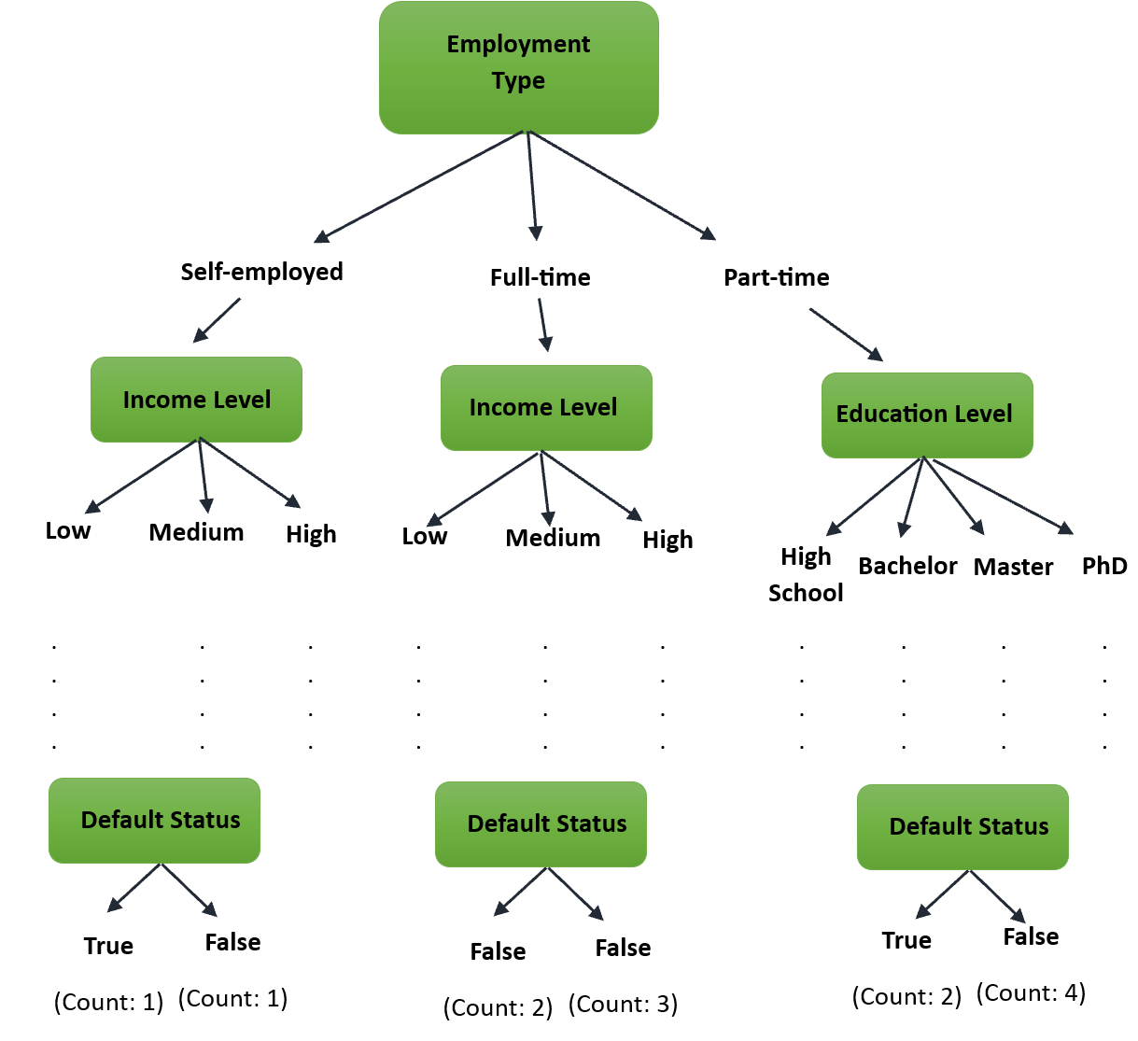
Result Interpretation
Chosen Model: Decision Tree
A flow chart tree split into decisions based on the previous title, each split/branch is a result of the decision. Begins with one title and expands into many due to many decisions
Split to get best split based on previous title
Goes through all non-target variables first according to best split then comes to a conclusion on the target variable (default status)
Counts how many true and false and these are the predictions which are compared with the actuals to get the accuracy
Highest recall of all models in correctly predicting actual defaulters

Slide 15
Pros & cons of decision tree
Pros:
Able to handle categorical and numerical variables
Performs classification without needing much computation
Easy to read
Informs of which variables are most important in predicting due to best fit
Cons:
Does not work well for predicting target variables that are numerical
Is vulnerable to errors in classification problems where the target variable has many categories and small number of training examples
A small change in the input will cause the decision tree to change completely

Slide 16
Machine learning
Machine Learning is a smaller part of AI and involves building systems that can learn from data and make predictions without being programmed to
It is able to handle very large datasets where normal methods don’t do well
Machine Learning allows for automation of tasks that may take too much time or is complex, increasing the productivity
Machine Learning is very good at predicting using data that is readily available
Allows for personalizations according to business needs
Able to detect complex patterns and anomalies which may not have been detected by human analyst
Improves with experience
Is able to help businesses make better decisions based on predictions and have an advantage over competitors

Slide 17
conclusion
Certain variables when plotted default status based on income level for example, from the graph it looks like it would not go to as we expect, but this is because the variable may be influenced by other variables as when we look at the dataset, many variables are taken into account to get the target variable default status.
The accuracy to predict correctly for all models in all train and test sets are around 81% due to the spread of data being very similar in every column
After performing balancing, achieved higher recall for all models, meaning the models are better at detecting defaulters, even if accuracy drops
The Decision Tree model is chosen as it has the highest recall and it is suitable for this dataset as seen from the model comparisons and pros and cons
Machine Learning improves with experience and has many advantages and uses including predicting very well by using data readily
This provides businesses to make better decisions based on the predictions, avoid more financial loss and have a competitive edge over competitors

